Slide 1
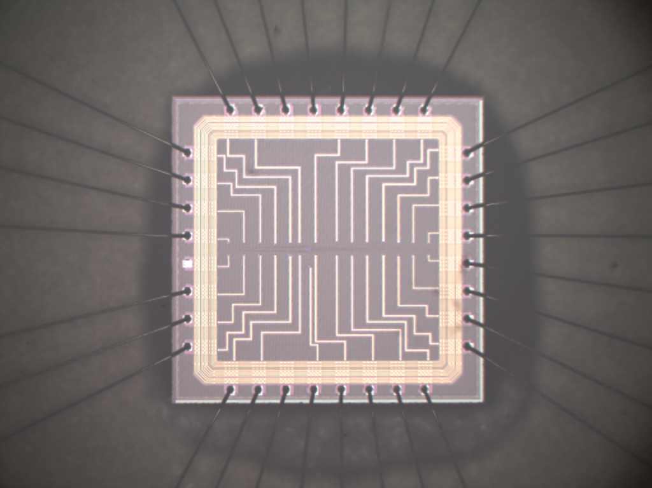
Y-Flash Summary
Rishona Daniels
Ilan Lipschutz
2024-Aug-4
L. Danial, E. Pikhay, E. Herbelin, N. Wainstein, V. Gupta, N. Wald, Y. Roizin, R. Daniel, W. Wang, D. Dutta, B. Hoffer, B. Oved, N. Reichler and S. Kvatinsky

Slide 2
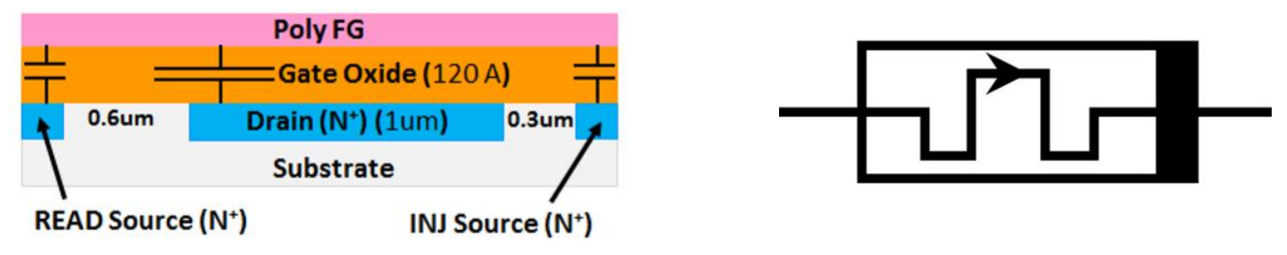

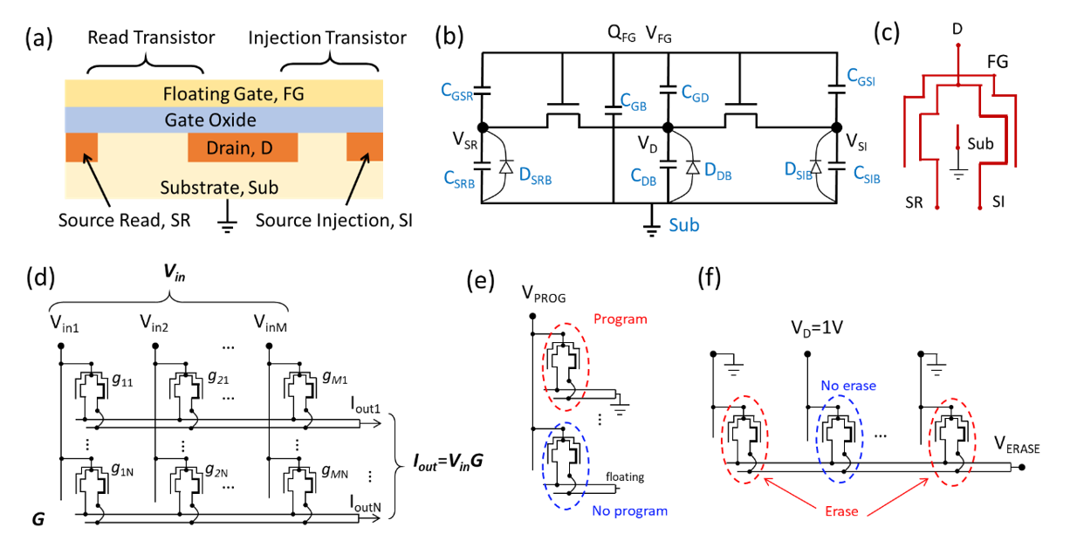
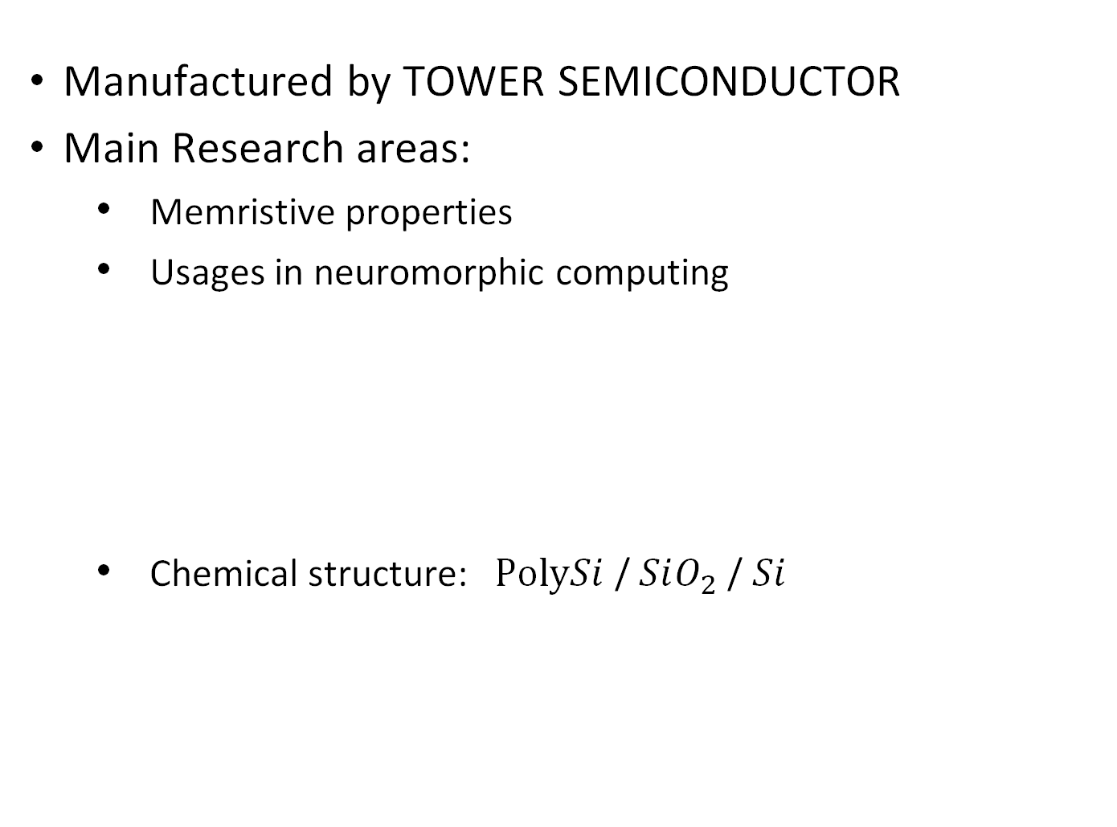
Y-Flash - Introduction
Manufactured by TOWER SEMICONDUCTOR
Main Research areas:
Memristive properties
Usages in neuromorphic computing
Chemical structure:$PolySi$ / $SiO_{2}$ / $Si$
Notes:
Two transistors; Read Transistor and Injection Transistor
Read transistor is longer (0.6um) and a lower threshold voltage
Injection transistor is shorter (0.3um) to enhance hot carrier injection
Capacitance of D is larger than cap of SR and cap of SI --> more coupling of FG to D

Slide 3
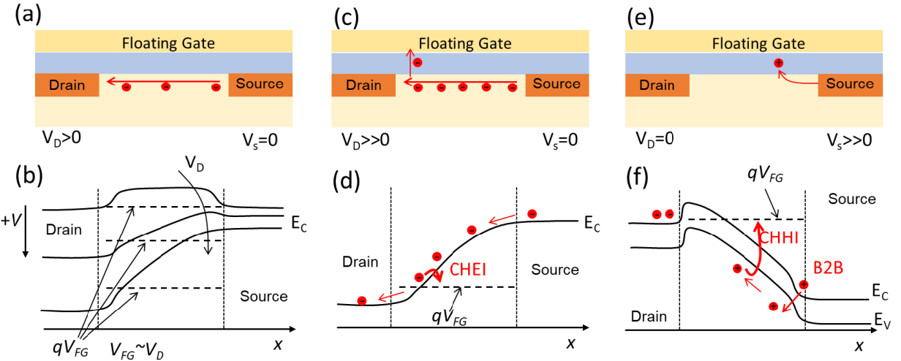
Y-Flash – Physics
Notes:
(a), (b) ==> Read opration --> Apply voltage at FG
(c), (d) ==> Program Operation ==> Charge Hot Electron Injection (CHEI) into the oxide ==> changes threshold voltage
(e), (f) ==> Erase Operation ==> holes generated by band-to-band tunneling, accelerated in channel, injected into FG by Channel Hot Hole Injection(CHHI)

Slide 4
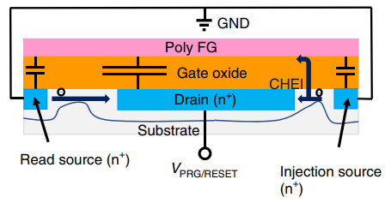
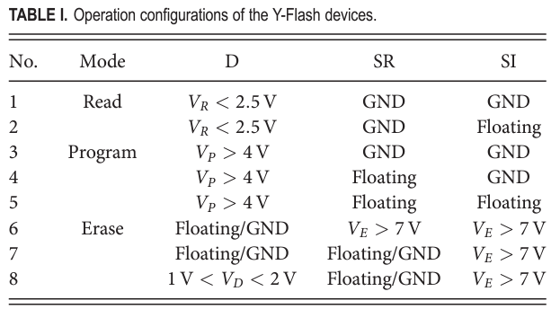
Y-Flash Cell - Operational Modes (Read)
Read Mode
Inject NR pulses of 1[uSec]
Minimum affect the RCELL value
VREAD

Slide 5
Y-Flash Cell - Operational Modes (Program)
Program Mode (RESET)
Inject NP pulses of 10[uSec]
RCELL depends on the number of the
injected program pulses (NP)
RCELL change is non-linear

Slide 6
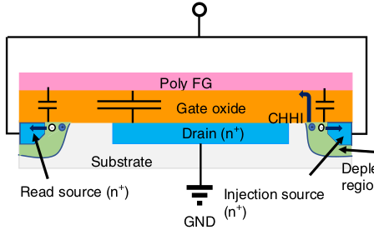
Y-Flash Cell - Operational Modes (Erase)
Erase Mode (SET)
Inject NE pulses of 10[uSec]
Initialize the RCELL value
VERS/SET
Depletion
region

Slide 7
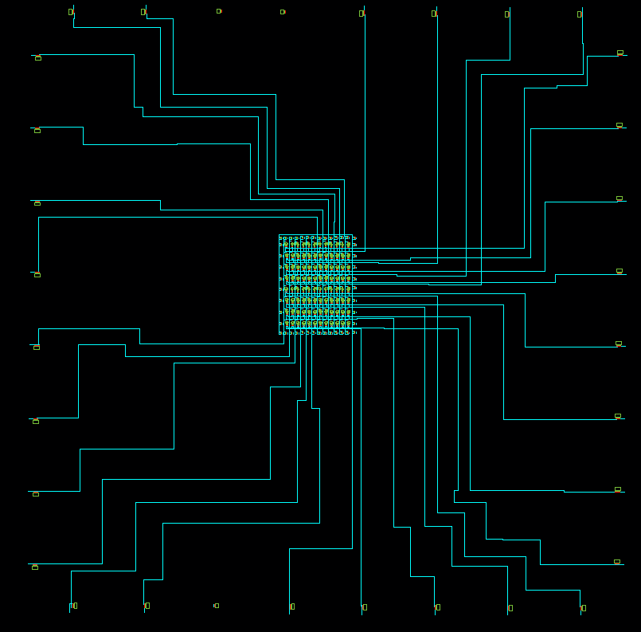
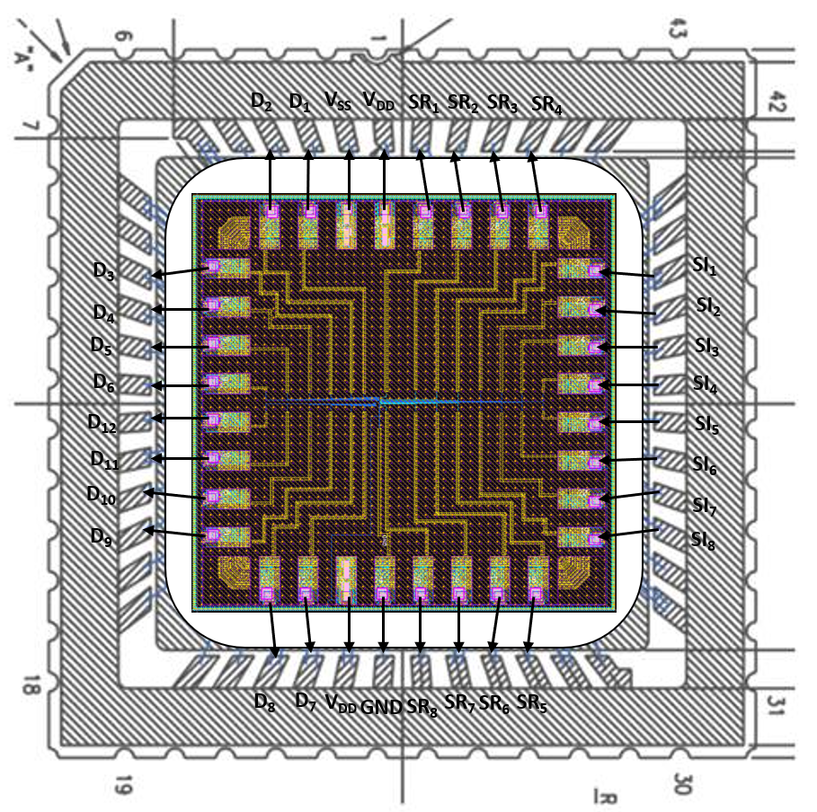
Y-Flash Die - 8x12 Cell Array Package

Slide 8
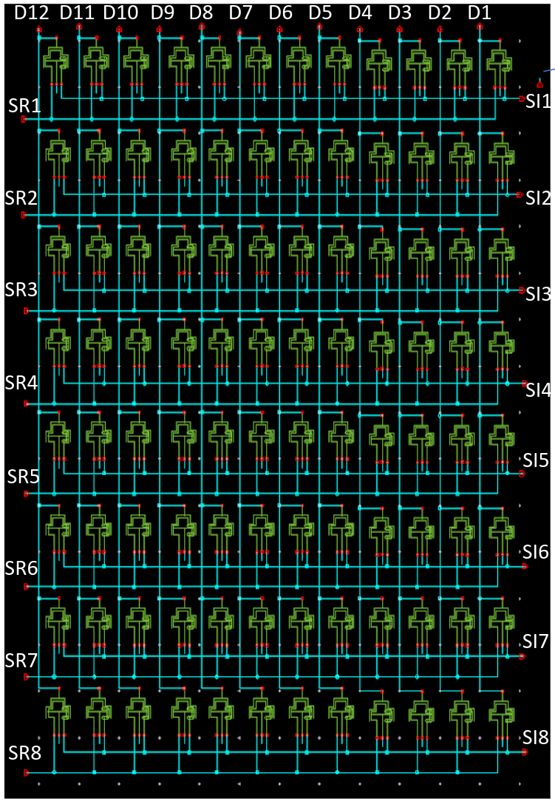
Y-Flash Die - 8x12 Cell Array Package

Slide 9
Y-Flash Die - 8x12 Cell Array Package
Drain (D)
Source Injection (SI)
Source Read (SR)

Slide 10
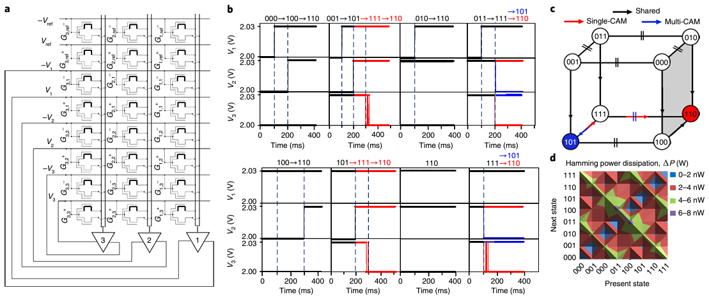
Y-Flash – Applications (Hopfield Network)
Notes:
Binary input

Slide 11
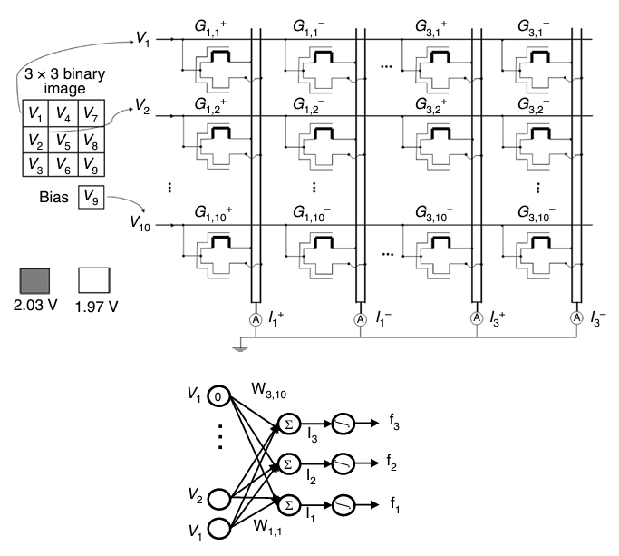
Y-Flash – Applications (ANN)
Notes:
Binary input

Slide 12
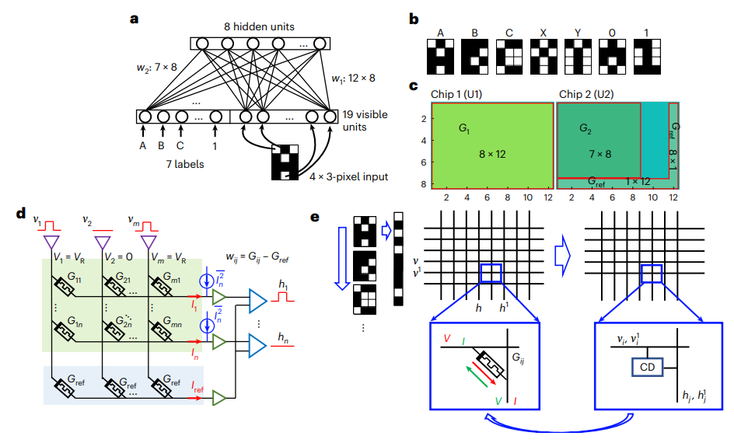
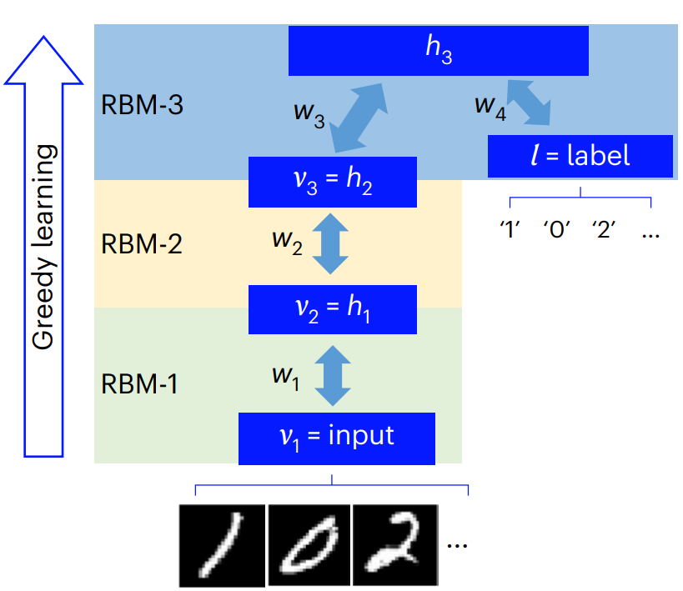
Y-Flash – Applications (DBN)
Notes:
Due to the non-ohmic I–V behaviour of the device, only binary input vectors are viable for the VMM operations, which meets the requirement of memristive RBMs and DBNs.

Slide 13
Y-Flash – References
Wang, W., et al. A memristive deep belief neural network based on silicon synapses. Nat Electron 5, 870–880 (2022).
Danial, L., et al. Two-terminal floating-gate transistors with a low-power memristive operation mode for analogue neuromorphic computing. Nat Electron 2, 596–605 (2019).
Wang, W., et al. Physical based compact model of Y-Flash memristor for neuromorphic computation. Appl. Phys. Lett. 27 December 2021; 119 (26): 263504.

Slide 14
Thank You

